Slide 1
T-SQL Concepts

Slide 2
CONCEPTS
GROUP BY
HAVING
ORDER BY
COMMON TABLE EXPRESSION
JOINS

Slide 3
GROUP BY
The GROUP BY statement groups rows that have the same values into summary rows, like "find the number of customers in each country".
The GROUP BY statement is often used with aggregate functions (COUNT, MAX, MIN, SUM, AVG) to group the result-set by one or more columns.

Slide 4
GROUP BY
GROUP BY clause is used with the SELECT statement.
In the query, GROUP BY clause is placed after the WHERE clause.
In the query, GROUP BY clause is placed before ORDER BY clause if used any.

Slide 5
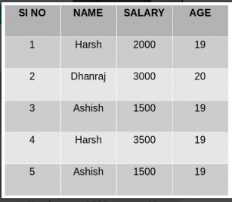
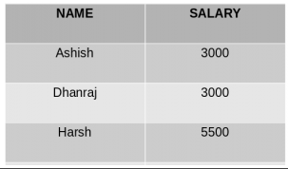
GROUP BY SINGLE COLUMN
SELECT NAME, SUM(SALARY) FROM Employee GROUP BY NAME;

Slide 6
GROUP BY SINGLE COLUMN
Group By single column means, to place all the rows with same value of only that particular column in one group.
The rows with duplicate NAMEs are grouped under same NAME and their corresponding SALARY is the sum of the SALARY of duplicate rows. The SUM() function of SQL is used here to calculate the sum.

Slide 7

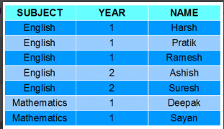
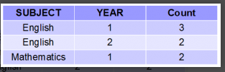
GROUP BY MULTIPLE COLUMN

Slide 8
GROUP BY MULTIPLE COLUMN
Group by multiple column is say for example, GROUP BY column1, column2. This means to place all the rows with same values of both the columns column1 and column2 in one group.
As you can see in the above output the students with both same SUBJECT and YEAR are placed in same group. And those whose only SUBJECT is same but not YEAR belongs to different groups. So here we have grouped the table according to two columns or more than one column.

Slide 9
HAVING CLAUSE SYNTAX
SELECT column1, function_name(column2)
FROM table_name
WHERE condition
GROUP BY column1, column2
HAVING condition
ORDER BY column1, column2;
function_name: Name of the function used for example, SUM() , AVG().
table_name: Name of the table.
condition: Condition used.

Slide 10
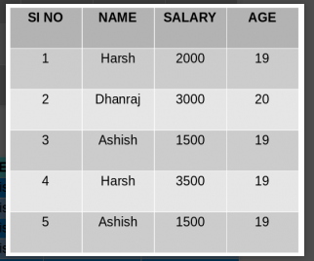

HAVING Clause
SELECT NAME, SUM(SALARY) FROM Employee GROUP BY NAME
HAVING SUM(SALARY)>3000;

Slide 11
HAVING Clause
WHERE clause is used to place conditions on columns. HAVING clause is used to place conditions to decide which group will be the part of final result-set.
Also we can not use the aggregate functions like SUM(), COUNT() etc. with WHERE clause. So we have to use HAVING clause if we want to use any of these functions in the conditions.
As you can see in the above output only one group out of the three groups appears in the result-set as it is the only group where sum of SALARY is greater than 3000. So we have used HAVING clause here to place this condition as the condition is required to be placed on groups not columns.

Slide 12
ORDER BY
Firstly, specify a column name or an expression on which to sort the result set of the query.
If you specify multiple columns, the result set is sorted by the first column and then that sorted result set is sorted by the second column, and so on.
ASC sorts the result from the lowest value to the highest value.
DESC sorts the result set from the highest value to the lowest one.
If you don’t explicitly specify ASC or DESC, SQL SERVER uses ASC as the default sort order.
Also, SQL Server treats NULL as the lowest values.
SELECT select_list FROM table_name ORDER BY column/s [ASC | DESC ]

Slide 13
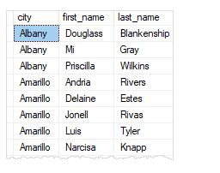
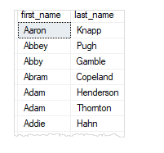
ORDER BY
Sort a result set by one column in ascending order
Sort a result set by multiple columns
SELECT first_name, last_name
FROM sales.customers
ORDER BY first_name;
SELECT city, first_name, last_name FROM sales.customers
ORDER BY city, first_name;

Slide 14
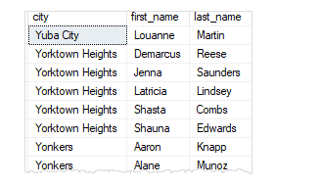
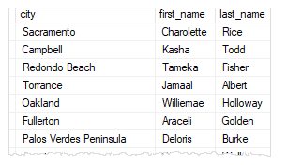
ORDER BY
Sort a result set by multiple columns and different orders
Sort a result set by a column that is not in the select list
SELECT city, first_name, last_name
FROM sales.customers
ORDER BY city DESC, first_name ASC;
SELECT city, first_name, last_name FROM sales.customers ORDER BY state;

Slide 15
ORDER BY
Sort by ordinal positions of columns:
SQL Server allows you to sort the result set based on the ordinal positions of columns that appear in the select list.
The following statement sorts the customers by first name and last name. But instead of specifying the column names explicitly, it uses the ordinal positions of the columns.
SELECT first_name, last_name
FROM sales.customers ORDER BY 1, 2;

Slide 16

Using the ordinal positions of columns in the ORDER BY clause is considered as bad programming
practice for a couple of reasons.
First, the columns in a table don’t have ordinal positions and need to be referenced by name.
Second, when you modify the select list, you may forget to make the corresponding changes in the ORDER BY clause.
Therefore, it is a good practice to always specify the column names explicitly in the ORDER BY clause.

Slide 17
CTE In SQL Server
CTE is a temporary result set and typically it may be a result of complex sub-query.
Unlike the temporary table, its life is limited to the current query. It is defined by using WITH statement.
A Common Table Expression, also called as CTE in short form, is a temporary named result set that you can reference within a SELECT, INSERT, UPDATE, or DELETE statement.

Slide 18

How to write a clean CTE Query:
Here are some basic guidelines that need to be followed to write a good CTE Query.
1.A CTE must be followed by a single SELECT, INSERT, UPDATE, or DELETE statement that references some or all the CTE columns.
2.Multiple CTE query definitions can be defined in a non recursive CTE.
3.A CTE can reference itself and previously defined CTEs in the same WITH clause
4.We can use only one With Clause in a CTE
5.ORDER BY, INTO, COMPUTE or COMPUTE BY, OPTION, FOR XML cannot be used in non-recursive CTE query definition
6.SELECT DISTINCT, GROUP BY, HAVING, Scalar aggregation, TOP, LEFT, RIGHT, OUTER JOIN (INNER JOIN is allowed) subqueries cannot be used in a recursive CTE query definition.

Slide 19
CTE Syntax: The CTE query starts with a “With” and is followed by the Expression Name. We will be using this expression name in our select query to display the result of our CTE Query and be writing our CTE query definition. WITH expression_name [ ( column_name [,...n] ) ] AS ( CTE_query_definition ) To view the CTE result we use a Select query with the CTE expression name: Select [Column1,Column2,Column3 …..] from expression_name or Select * from expression_name

Slide 20

;WITH itemCTE (Item_ID, Item_Name, Item_Price,MarketRate,SalesYear)
AS
(
SELECT Item_ID, Item_Name, Item_Price ,'Present Price' as MarketRate, YEAR(Date) as SalesYear FROM ItemDetails
UNION ALL
SELECT Item_ID as Item_ID, Item_Name,
(Item_Price + (Item_Price *10 )/100) as Item_Price,
'Future Price' as MarketRate, YEAR(dateadd(YEAR, 1, Date)) as SalesYear
FROM ItemDetails
)
SELECT * from itemCTE Order by Item_Name,SalesYear
;WITH itemCTE (Item_ID, Item_Name, Item_Price,SalesYear)
AS
(
SELECT Item_ID, Item_Name, Item_Price ,YEAR(Date) SalesYear
FROM ItemDetails
)
Select * from itemCTE
The first scenario is to display each Item Price
of current Year.
The second scenario is to increment 10% to
each Item Price for next year.

Slide 21
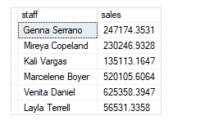
a. Simple SQL Server CTE example:
This query uses a CTE to return the sales amounts by sales staffs in 2018:
WITH cte_sales_amounts (staff, sales, year) AS (
SELECT
first_name + ' ' + last_name,
SUM(quantity * list_price * (1 - discount)),
YEAR(order_date)
FROM
sales.orders o
INNER JOIN sales.order_items i ON i.order_id = o.order_id
INNER JOIN sales.staffs s ON s.staff_id = o.staff_id
GROUP BY
first_name + ' ' + last_name,
year(order_date)
)
SELECT staff, sales
FROM cte_sales_amounts
WHERE year = 2018;

Slide 22
b. Using a common table expression to make report averages based on counts:
This example uses the CTE to return the average number of sales orders in 2018 for all sales staffs.
WITH cte_sales AS (
SELECT
staff_id,
COUNT(*) order_count
FROM
sales.orders
WHERE
YEAR(order_date) = 2018
GROUP BY
staff_id
)
SELECT AVG(order_count) average_orders_by_staff
FROM cte_sales;
average_orders_by_staff
-----------------------
48
(1 row affected)

Slide 23
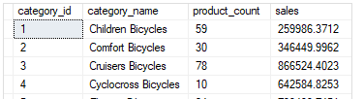
c. Using multiple SQL Server CTE in a single query example:
The following example uses two CTE cte_category_counts and cte_category_sales to return the number of the products and sales for each product category. The outer query joins two CTEs using the category_id column.
SELECT
c.category_id,
c.category_name,
c.product_count,
s.sales
FROM
cte_category_counts c
INNER JOIN cte_category_sales s
ON s.category_id = c.category_id
ORDER BY
c.category_name;
WITH cte_category_counts (
category_id,
category_name,
product_count
)
AS (
SELECT
c.category_id,
c.category_name,
COUNT(p.product_id)
FROM
production.products p
INNER JOIN production.categories c
ON c.category_id = p.category_id
GROUP BY
c.category_id,
c.category_name
),
cte_category_sales(category_id, sales) AS (
SELECT
p.category_id,
SUM(i.quantity * i.list_price * (1 - i.discount))
FROM
sales.order_items i
INNER JOIN production.products p
ON p.product_id = i.product_id
INNER JOIN sales.orders o
ON o.order_id = i.order_id
WHERE order_status = 4 -- completed
GROUP BY
p.category_id
)

Slide 24
SQL SERVER JOINS
In a relational database, data is distributed in multiple logical tables.
To get a complete meaningful set of data, you need to query data from these tables by using joins.
SQL Server supports many kinds of joins including inner join, left join, right join, full outer join, and cross join.
Each join type specifies how SQL Server uses data from one table to select rows in another table.

Slide 25
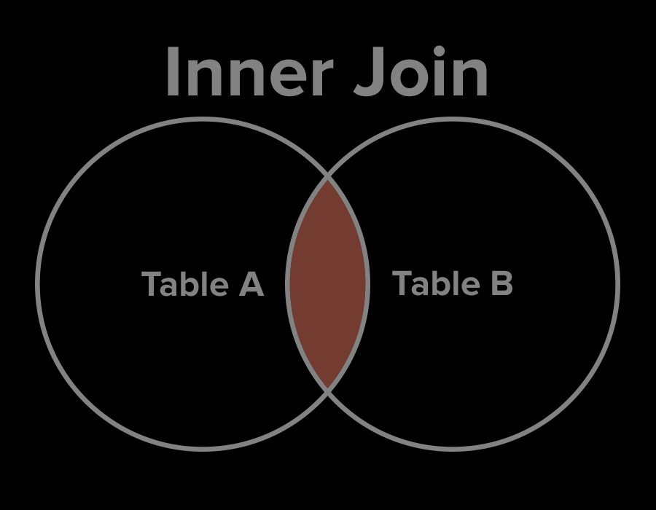



INNER JOIN
Inner join produces a data set that includes rows from the left table which have matching rows from the right table.
EMPLOYEE
MANAGER
Select * from #EmployeeTable e inner join
#ManagerTable m on e.EmployeeID=m.EmployeeID

Slide 26
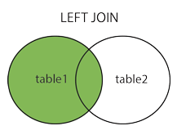

LEFT JOIN
Left join selects data starting from the left table and matching rows in the right table.
The left join returns all rows from the left table and the matching rows from the right table.
If a row in the left table does not have a matching row in the right table, the columns of the right table will have nulls.
EMPLOYEE
MANAGER
Select * from #EmployeeTable e left join
#ManagerTable m on e.EmployeeID=m.EmployeeID

Slide 27
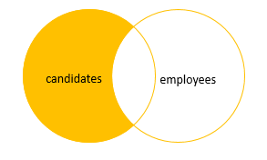
ROWS IN LEFT TABLE
To get the rows that available only in the left table but not in the right table, you add a WHERE clause to the query.
EMPLOYEE
MANAGER
Select * from #EmployeeTable e left join #ManagerTable m on e.EmployeeID=m.EmployeeID
where m.EmployeeID is NULL

Slide 28
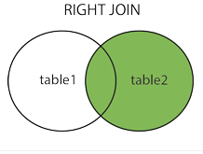

RIGHT JOIN
The right join returns a result set that contains all rows from the right table and the matching rows in the left table.
If a row in the right table that does not have a matching row in the left table, all columns in the left table will contain nulls.
EMPLOYEE
MANAGER
Select * from #EmployeeTable e right join
#ManagerTable m on e.EmployeeID=m.EmployeeID

Slide 29
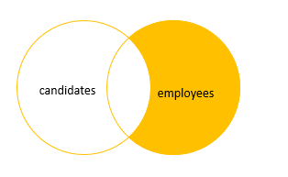
ROWS IN RIGHT TABLE
You can get rows that are available only in the right table by adding a WHERE clause to the query.
EMPLOYEE
MANAGER
Select * from #EmployeeTable e right join
#ManagerTable m on e.EmployeeID=m.EmployeeID
where e.EmployeeID is NULL

Slide 30
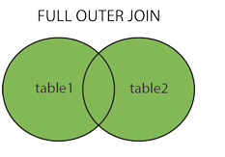
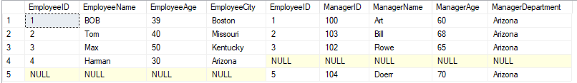
FULL JOIN
The full outer join or full join returns a result set that contains all rows from both left and right tables, with the matching rows from both sides where available.
In case there is no match, the missing side will have NULL values.
EMPLOYEE
MANAGER
Select * from #EmployeeTable e full join
#ManagerTable m on e.EmployeeID=m.EmployeeID

Slide 31
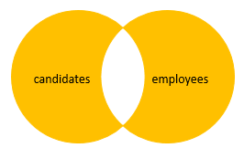
UNMATCHING ROWS IN BOTH TABLES
You exclude rows that are common to both tables by adding a WHERE clause in the query.
EMPLOYEE
MANAGER
Select * from #EmployeeTable e full join #ManagerTable m on e.EmployeeID=m.EmployeeID
where e.EmployeeID is NULL or m.EmployeeID is NULL

